Slide 1
RCBD and Mixed Model
Feb 20 2018

Slide 2
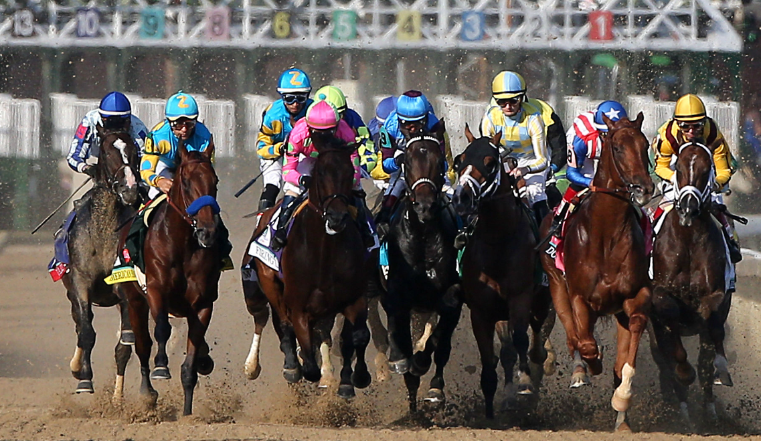
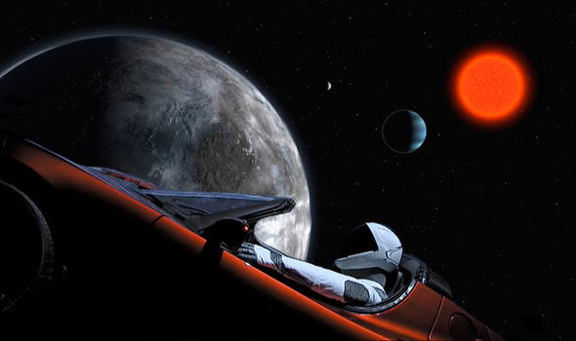
The Kentucky Derby
Tesla’s Space Travel
We are in an exciting world where data scientists are very much needed
the Run for the Roses and the Beauty of the Speed
Exploration of the Unknown with Mankind’s Curiosity

Slide 3
Survey Feedback
Thank you first of all to fill the feedback
Overall quite encouraging feedback from the class
I will focus on the ones that will need to improve with below examples
SAS Background is lacking for some students
no Feedback on homework and quiz
Homework is unclear and somewhat difficult
I will ask the class a favor more participation for the End of Semester Evaluation

Slide 4
PROC Mixed
REML (Restricted Maximum Likelihood) VS. Least Square Estimate in PROC GLM
Introduce BLUP computation for Random Effects
can compute Intraclass correlations (in certain case, equivalent to Heritability/Repeatability of experiments)
in real world not-that-perfected case, deals perfectly well when data is not balanced, or missing data

Slide 5
Fixed or Random effects? some Guidelines
 | Fixed Effects | Random Effects
LEVELs | Finite # of factor levels | Selected at random from conceptually infinite collection of possibilities
For other new experiments | Would use the same level again as factor | Would be different levels from same population
Goal | Estimate means | Estimate Variance components
Inference | Only for the exact levels used in the experiments | For all levels of the factors (population attributes)

Slide 6
Simulation to generate a farm milk production data
data Sim;
keep Species Farm Animal Yield;
array AnimalEffect{300};
array AnimalFarm{300};
array AnimalSpecies{300};
do i = 1 to dim(AnimalEffect);
AnimalEffect{i} = sqrt(5.0)*rannor(12345);
AnimalFarm{i} = 1 + int(100*ranuni(12345));
AnimalSpecies{i} = 1 + int(5*ranuni(12345));
end;
do i = 1 to 4000;
Animal = 1 + int(300*ranuni(12345));
Species = AnimalSpecies{Animal};
Farm = AnimalFarm{Animal};
Yield = 1 + Species + Farm/10 + AnimalEffect{Animal}
+ sqrt(11.0)*rannor(12345);
output;
end;
run;
data Sim;
set Sim;
if Yield>0;
run;
proc sort;
by Animal;
ods pdf file="C:\Pipeline\AnimalFarm.pdf";
proc mixed data=Sim covtest method=reml;
class Species Farm;
model Yield = Species;
random farm /solution;
lsmeans species;
*test Species;
estimate 'Species1 = Species3' Species 1 0 -1 0 0;
run;
ods pdf close;

Slide 7
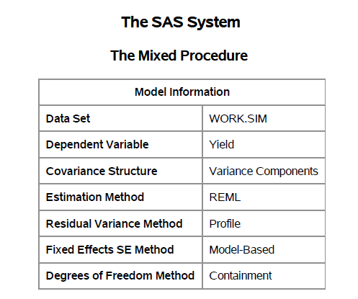
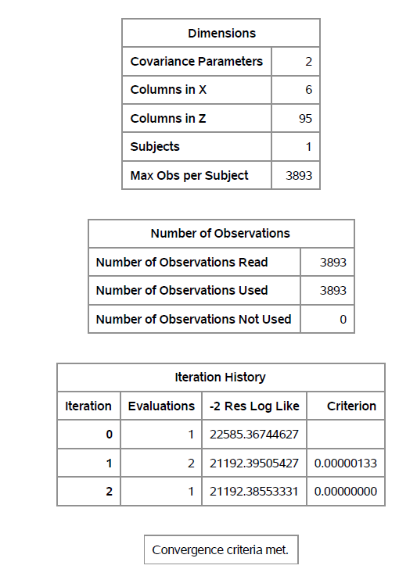
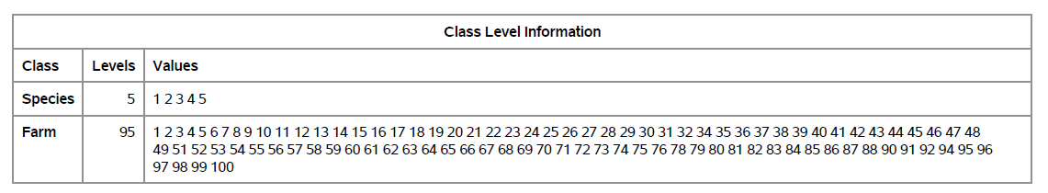

Slide 8
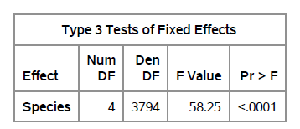
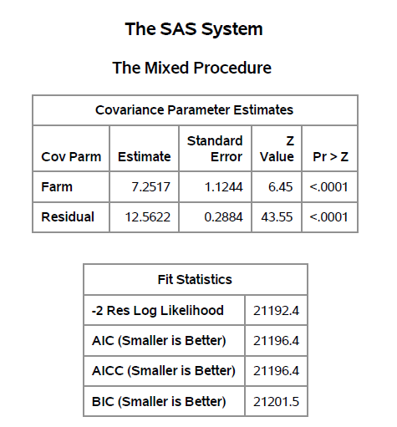
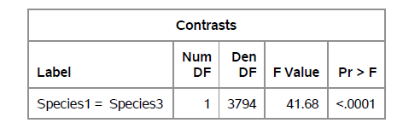
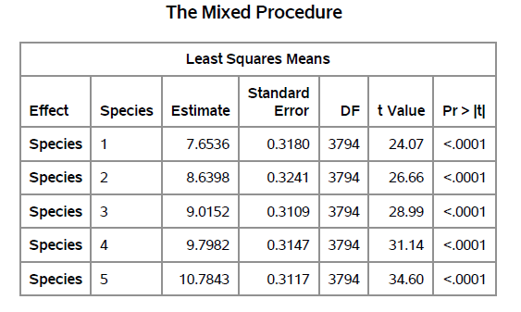
Intraclass Correlation: 7.2517/(7.2517+12.5622)=?

Slide 9
Revisit Soybean Data
*** Example of RBD ***;
*** From Snedecor & Cochran, 1980 (pg 256) ***;
proc GLM data=SOYBEAN;
class treatment block;
model failures = treatment block;
random block;
output out=soybeanm p=pred r=resid;
lsmeans treatment / pdiff adjust=tukey;
contrast 'check vs fermate' treatment 0 -1 1 0 0;
run;
DATA SOYBEAN;
INPUT treatment $ BLOCK $ FAILURES;
TITLE1 'FAILURES TO GERMINATE OF SOYBEAN PLANTS';
TITLE2 '4 TREATMENTS AND A CONTROL, 5 BLOCKS';
CARDS;
CHECK 1 8
CHECK 2 10
CHECK 3 12
CHECK 4 13
CHECK 5 11
ARASAN 1 2
ARASAN 2 6
ARASAN 3 7
ARASAN 4 11
ARASAN 5 5
SPERGON 1 4
SPERGON 2 10
SPERGON 3 9
SPERGON 4 8
SPERGON 5 10
SEMESAN 1 3
SEMESAN 2 5
SEMESAN 3 9
SEMESAN 4 10
SEMESAN 5 6
FERMATE 1 9
FERMATE 2 7
FERMATE 3 5
FERMATE 4 5
FERMATE 5 3
;
PROC MIXED DATA=SOYBEAN cl COVTEST;
CLASS treatment BLOCK;
MODEL FAILURES = treatment / htype=3 DDFM=Satterthwaite outp=ResidDataP;
RANDOM BLOCK;
lsmeans treatment / pdiff adjust=tukey;
contrast 'check vs fermate' treatment 0 -1 1 0 0;
RUN;
proc univariate data=ResidDataP plot normal; var resid;
run;
proc plot data=soybeanm;
plot resid*pred/vref=0;
plot failures*pred;
run;

Slide 10
Homework 2 – Overview of the Solution
Question 2.13
http://www.stat.ufl.edu/archived/casella/StatDesign/
Cheat Sheet

Slide 11
Quiz4
Related to the Farm Data
Generate the ANOVA table (3 points)
Calculate the Intraclass correlation for Farm effect (2 points)
Generate a contrast to compare the average of species 1 and 2 vs. that of species 4 and 5; is it significant? what is the p-value? (2 points)
If you have a choice to select ONE farm to raise your species, which one would you choose based on BLUP? Please also state your reason why (3 points)

Slide 12
Homework 3 (Due March 9th)
3.1(a); 3.3(a); 3.5; 3.7 (b) (c); 3.15 (a) (b) (d)
https://en.wikipedia.org/wiki/Kentucky_Derby
Use the Kentucky Derby Data with below 2 criteria:
1 and ¼ mile race only
Track Condition factors with at least 3 counts from 1896-2017
Answer the below questions:
Is this CRD or RCBD?
is Track Condition significant for the performance of the fastest horses?
Based on the historical data, What would you predict the Track condition for 2018 May race?

